Slide 1
Oculomotor Mobile Assessment Interface
(OMAI)
By: Bryan Xavier, Jonathan Scarduffa, Ryan Wilbur, Melvin Shajee
Advisor: Dr. Chang Yaramothu
Notes:
Melvin

Slide 2
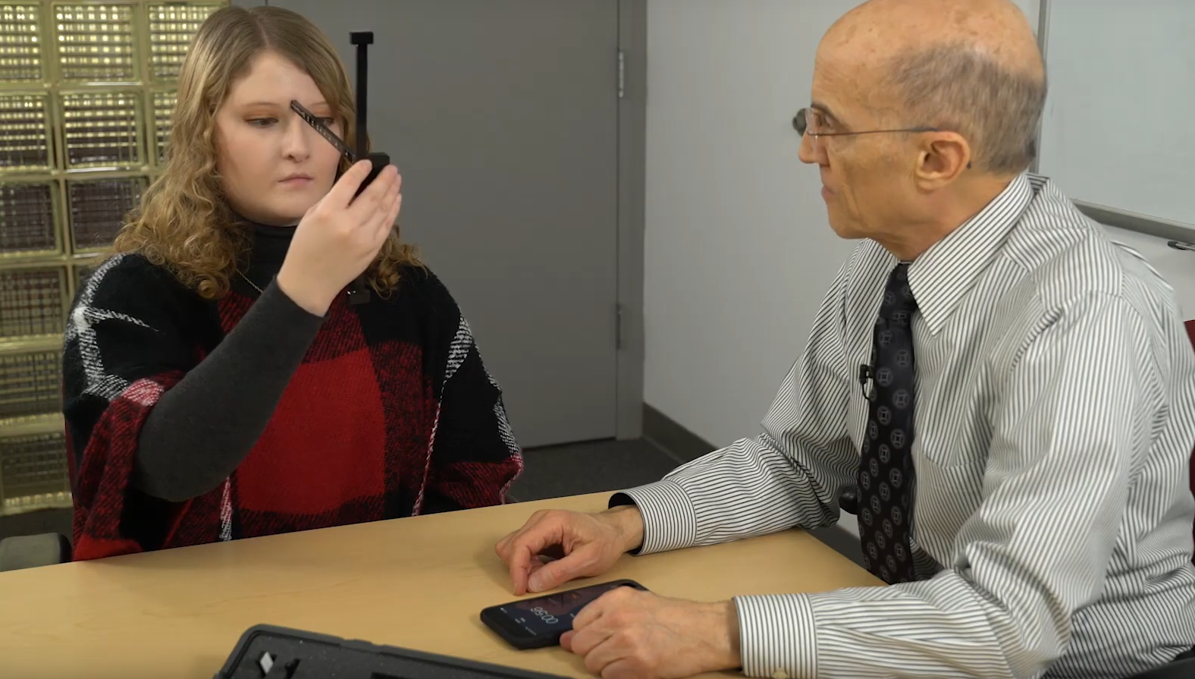
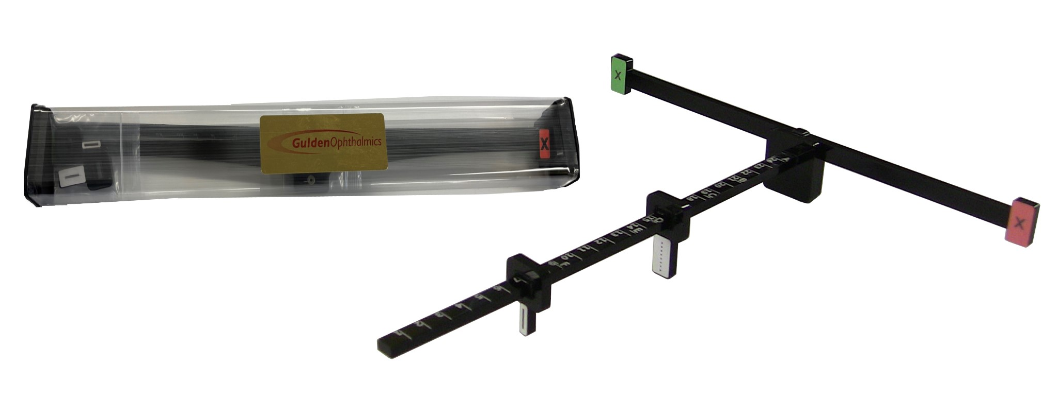
Concussions and the OMAT
Concussions are common mild traumatic brain injuries
Dizziness
Blurry vision
OMAT standardizes concussion screening
VOMS → MoVES
Consistent visual targets
Notes:
Melvin - Project Background

Slide 3
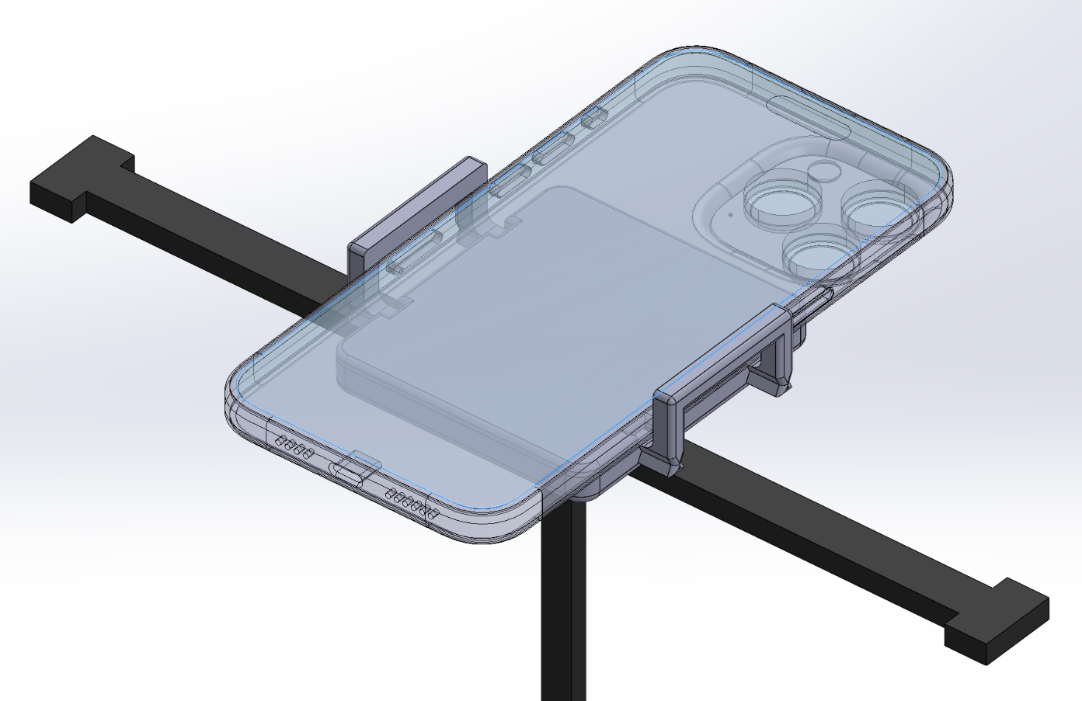
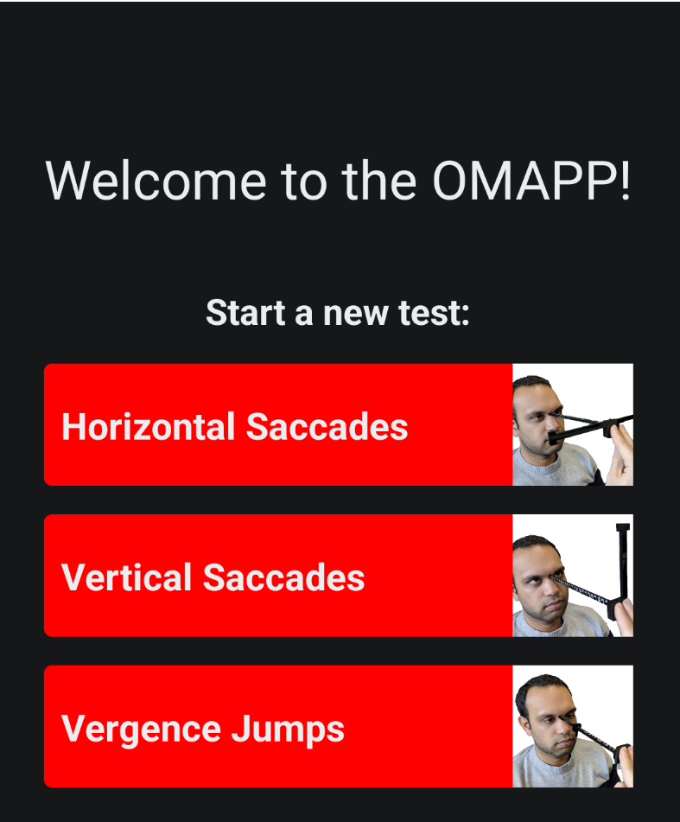
The OMAI
The OMAPP
Increases the consistency and ease of the MoVES procedure
Reduces number of items needed to be held
Provides a consistent platform for video recording
Facilitates recording eye movements
Provides a timer for testing
Facilitated mobile data collection, transfer, and analysis
Notes:
Melvin - Summary Description of Project Physical device on left holds multiple things at once, making it one part makes it more convenient Software on the right makes application more automatic

Slide 4
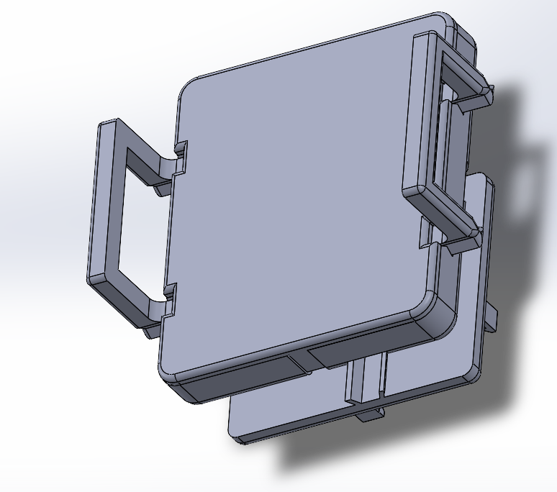
The OMAI
Back Case - Main housing for internal components
Front Case - Covering for internal Parts - Attached with Cyanoacrylate Adhesive and clips
Grippers - Direct Interface with Phone - Covered in Polyurethane foam
Springs - Stainless Steel - Spring Rate ≅ 0.31176 lbf/in
OMAT attachment clips - Allows for vertical and horizontal mounting
Notes:
Summary of The Final Design This is the final version of the tension springs design. A newly added piece is the back clip. We added clips on the side to open and show the internals

Slide 5
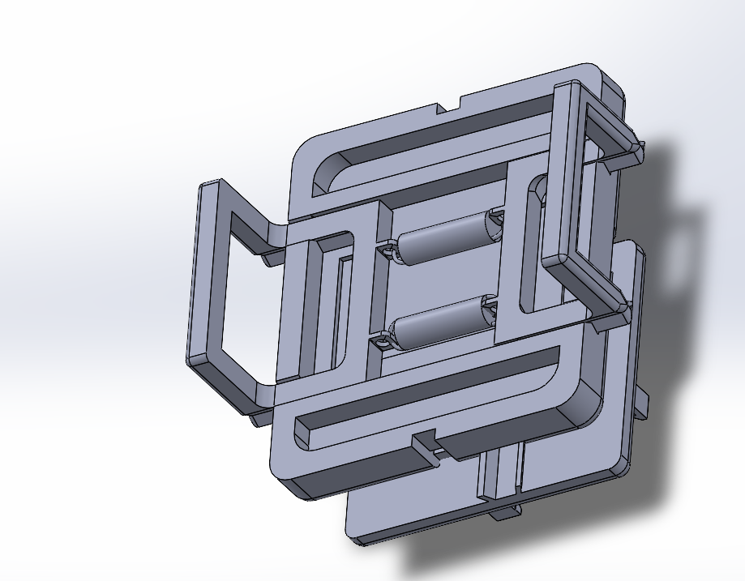
Internal view
The final design has 2 internal springs connecting the grippers on their tracks.
The bottom has a set screw that is able to be tightened or loosened by hand at any time.
The set screw sits under the OMAT attachment site.
Notes:
Summary of The Final Design This is the new clip piece for the OMAI. It has a nut and set screw to limit movement on the back. This allows for the app to be simplified by not needing to rotate.

Slide 6
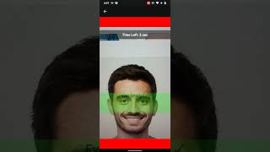
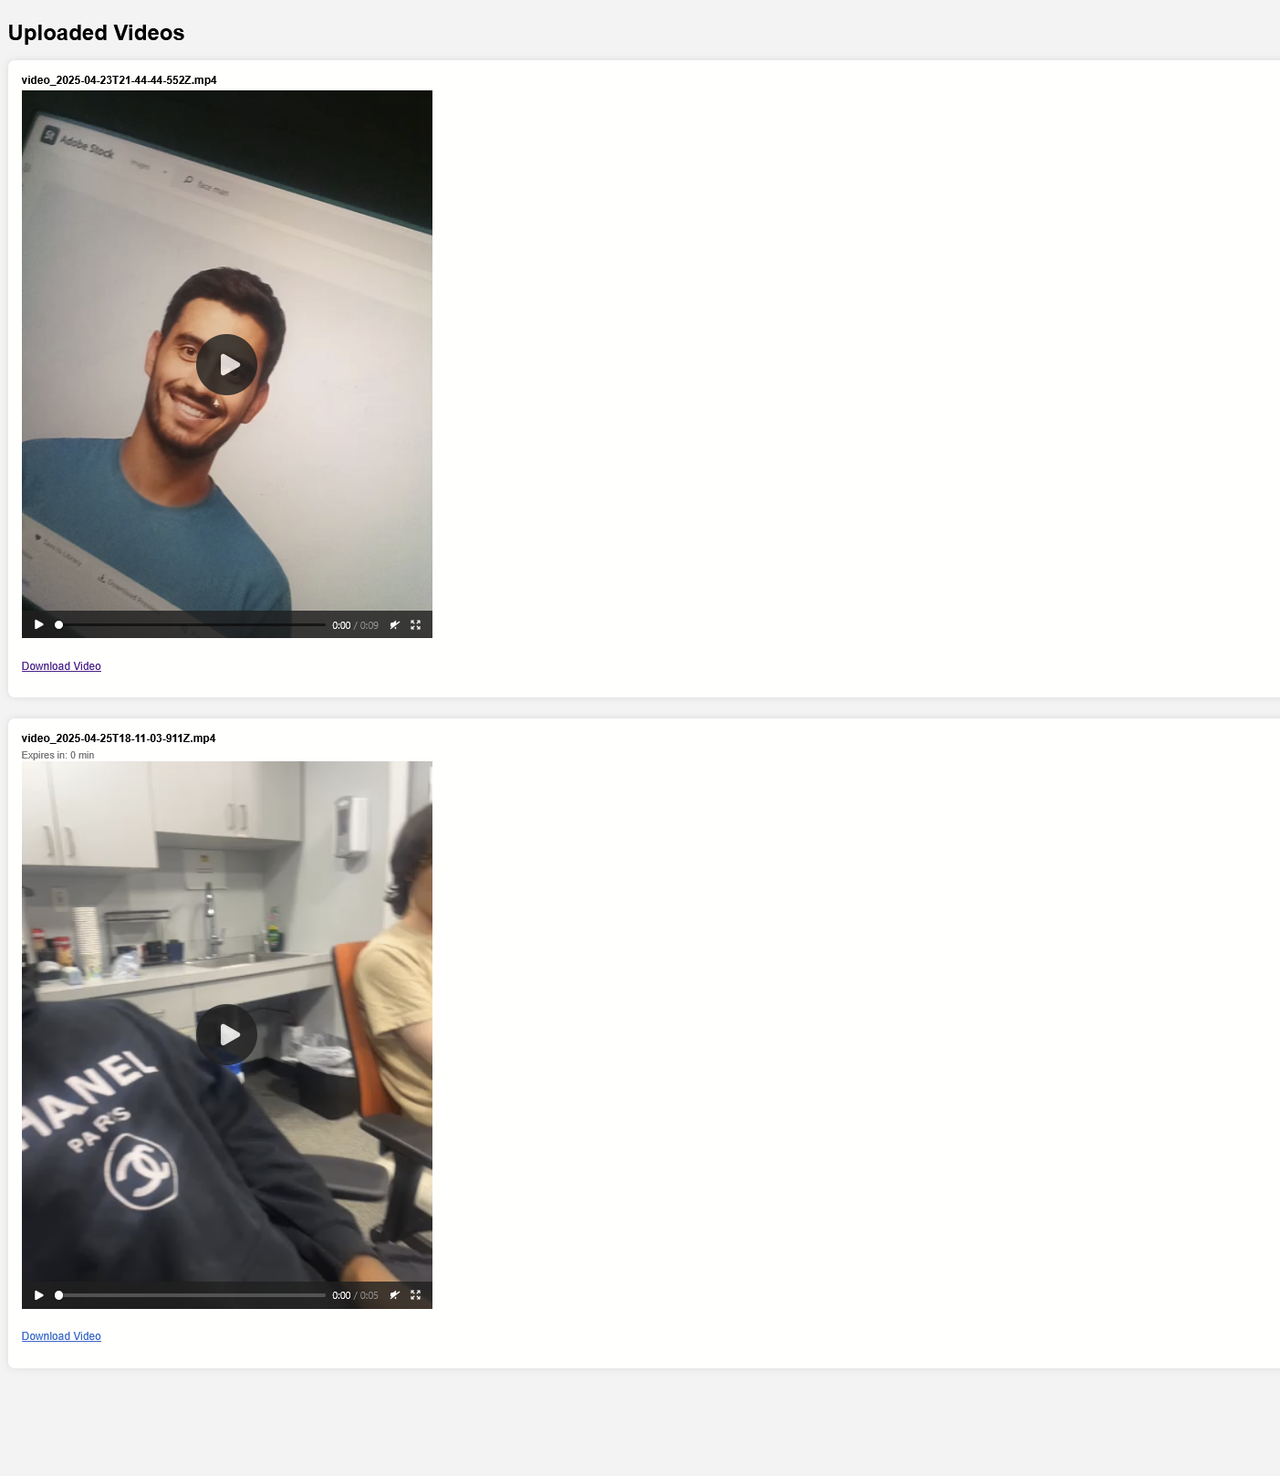
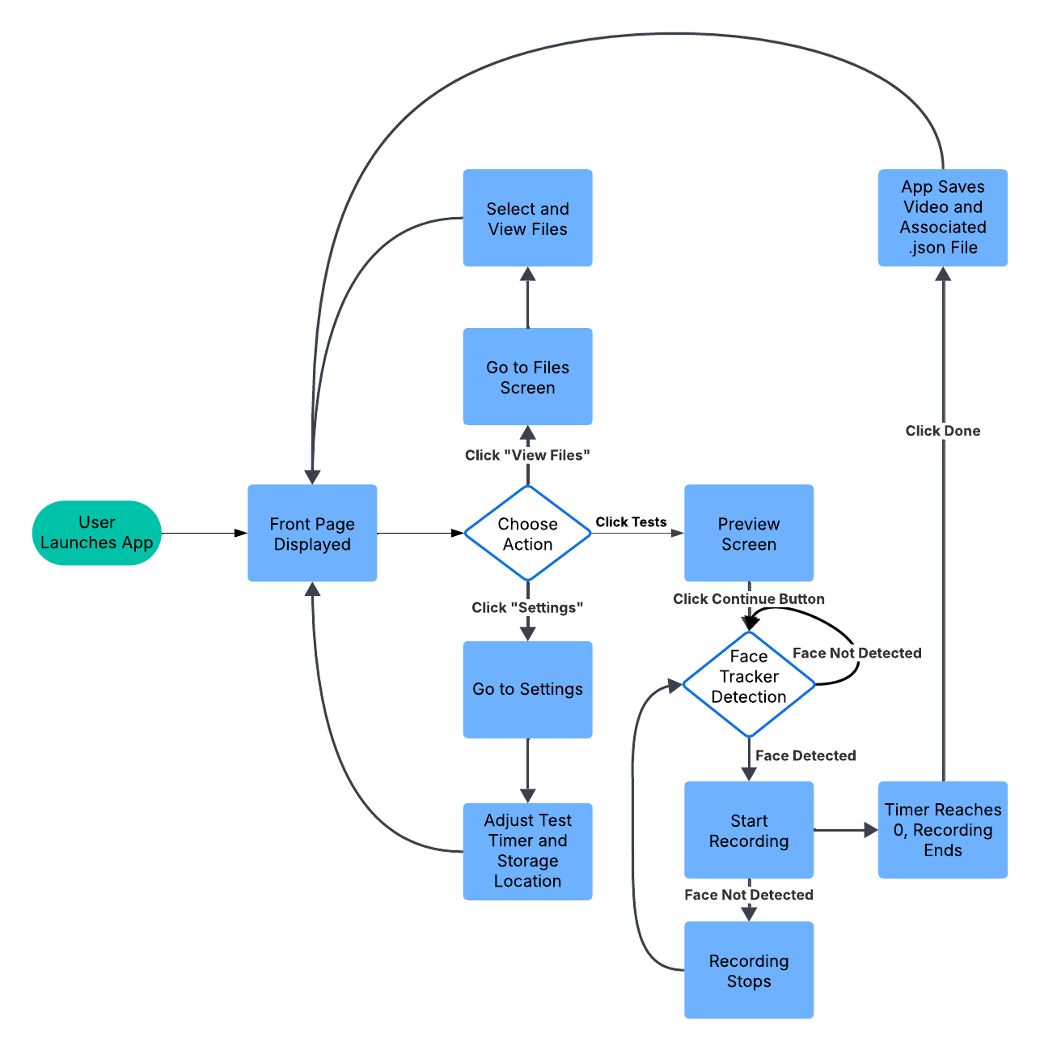
OMAPP
Logic Diagram
Server Side Video Hosting
Notes:
Bryan - Summary of The Final Design
For the basic workflow of our app, the user starts with attaching the OMAT and its interface to the phone, the user then opens the app and can select one of the three tests, which the app will provide a screen with instructions for said test. Our app automatically saves each recorded video to either a default location or a folder specified by the user in the settings screen. These videos are saved along with a placeholder metadata file meant logs eye movements detected during the recording. User’s can then either view the most recent recording immediately after or access a built in file browser within the app to view and play back any saved recordings.

Slide 7
Traceability
Customer Needs | Requirements | Tests | Test Results | Comments
Compatibility with various phone sizes | Fits most iPhones and Android, with cases | Check if minimum and maximum phone dimensions with cases fit securely | Pass | Prototype has been tested
Secure mounting and camera alignment | OMAT attaches securely and aligns with camera (vertically and horizontally) | Ensure OMAT stays in place against a sudden force and aligns camera with vergence bar | Pass | No Comment
Web app guidance for eye alignment | Web app provides guidance for correct positioning of eyes | User testing confirms alignment guidance during recording is effective | Pass | No Comment
Video recording, processing, and saving | App records and sends video for analysis, saves video, includes binary eye detection. | Binary eye detection validated by the test administrator, record video, check system file directory for saved video, receive result from server | Pass | There is stutter recording the video on older android devices (5+).
Timer and test functions for duration settings | App allows for test duration customization | Set timer in settings for 5 seconds, and record time app spends recording to confirm they match | Pass | No comments
Notes:
Bryan - (Show the traceability from Customer Needs to Test Results) This is a traceability chart to ensure that our product meets customer needs. We’ve already tested with confirmation that it supports a wide range of phone sizes and but still need to test for secure mounting for the OMAT. We also are currently going through testing on whether our application provides reliable binary eye detection for guidance and video recording and saving functionality. Right now for android systems, the web app allows for video duration customization, saving videos at specific locations, and retrieval of video file to be displayed.

Slide 8
Summary of Test Results
Hardware
Software
Item | Test Result: | Pass/Fail
Clip Horizontal Fixation | No movement | Pass
Clip Vertical Fixation | No movement | Pass
OMAT 1 Attachment | Successful Attachment | Pass
OMAT 2 Attachment | Successful Attachment | Pass
2.64 in Width Model | Grippers Successfully hold Model | Pass
3.11 in Width Model | Grippers Successfully hold Model | Pass
Item | Test Result: | Pass/Fail
App Navigation and UI | All screens can be accessed to and can backtrack at most pages. Clearly shows what screen will be accessible. | Pass
Recording Functions | Video can be recorded, deleted, and saved | Pass
Playback & Replay | Video can be played back before and after saving | Pass
File Management | User can view files after recording and on Android can set a specific path | Pass
Cross Platform Support | App functions work on both iOS and Android | Pass
Notes:
(Summary of Results of Test Plan Execution) Job designman- Our current design has passed all of the hardware tests(hopefully i can say that i need to pick up the piece) All of the physical design requirements have been met but we still need to test the set screw and nut for how well it holds the back clip.
Bryan, who’s basically a lung in a jar
All the screens in the app have been made already, and all of them are able to be accessed. We made two separate builds of the app to test file saving and face detection, and need to merge and test the functions together. We also need to translate these function for iOS systems.

Slide 9
Discussion of Test Results and Product Alignment with Customer Requirements.
Video recording, processing, and saving | App records and sends video for analysis, saves video, includes binary eye detection. | Binary eye detection validated by user, record video, check system file directory for saved video, receive result from server | Pass
Hardest
App Function | Testing Done | Results | Comments
Constant Face Detection | App is able to detect whether a face in camera view or not before and during recording | Pass | Side profiles still trigger the recording starting
File Saving/Playback | App is able to save/retrieve the files onto Android and IOS systems. | Pass | In Android, files can be saved in the app or the system’s file directory; in iOS, only in the app.
Server Data Transfer | App is able to send videos and receive metadata from external server | Pass | Proof of concept function that will be moved to another server later
File Deletion | App is able to allow deletion of the files. | Pass | In Android, files can be deleted through the app or the system’s file directory; in iOS, only through the app.
Camera Access | App is able to access Camera when initiating test. | Pass
Easiest
Notes:
Melvin - Detailed Discussion of Test Results and how your product meets the customer Part 1.
needs/requirements
A lot of our issues stemmed from a lack of documentation or the context needed to understand it.

Slide 10
Discussion of Test Results and Product Alignment with Customer Requirements.
Timer and test functions for duration settings | App allows for test duration customization | Set timer in settings for 5 seconds, and record time app spends recording to confirm they match | Pass
Hardest
App Function | Testing Done | Results | Comments
Timer Countdown | Observe that a timer is visible during recording and ends the recording once the timer reaches 0. | Pass | The timer reaching 0 initiates the video recording, and the face detection ending. The camera will turn off two seconds later to avoid crashing.
Test Duration Settings | Verify if the number of seconds set for a test duration matches how long a video recording is. | Pass
Web app guidance for eye alignment | Web app provides guidance for correct positioning of eyes | User testing confirms alignment guidance during recording is effective | Pass
App Function | Testing Done | Results | Comments
Bar changes color based on if eye is present in camera view | Bar changes color based on if eye is present in camera view | Pass | The bar color changes based on detecting a face in the camera view.
Easiest
Notes:
Bryan - Detailed Discussion of Test Results and how your product meets the customer Part 2.
needs/requirements

Slide 11
Discussion of Test Results and Product Alignment with Customer Requirements.
Compatibility with various phone sizes | Compatibility with various phone sizes | Fits most iPhones and Android, with cases | Pass
OMAI compatibility | Testing Done | Results | Comments
Minimum dimensions | Cut a piece of wood to 2.64 in and put the wood in the OMAI. | Pass
Maximum dimensions | Melvin’s phone is the maximum dimension of 3.11 in so his phone was tested for the OMAI. | Pass
Hardest
Secure mounting and camera alignment | OMAT attaches securely and aligns with camera (vertically and horizontally) | Ensure OMAT stays in place against a sudden force and aligns camera with vergence bar | Pass
OMAI compatibility | Testing Done | Results | Comments
OMAI attaches OMAT and is secure | OMAT is placed in OMAI and is left hanging then is shaken up and down, and left and right. | Pass
Camera alignment | Put OMAI both ways and make confirm the camera still has view of the eyes. | Pass
Easiest
Notes:
Detailed Discussion of Test Results and how your product meets the customer Part 1.
needs/requirements

Slide 12
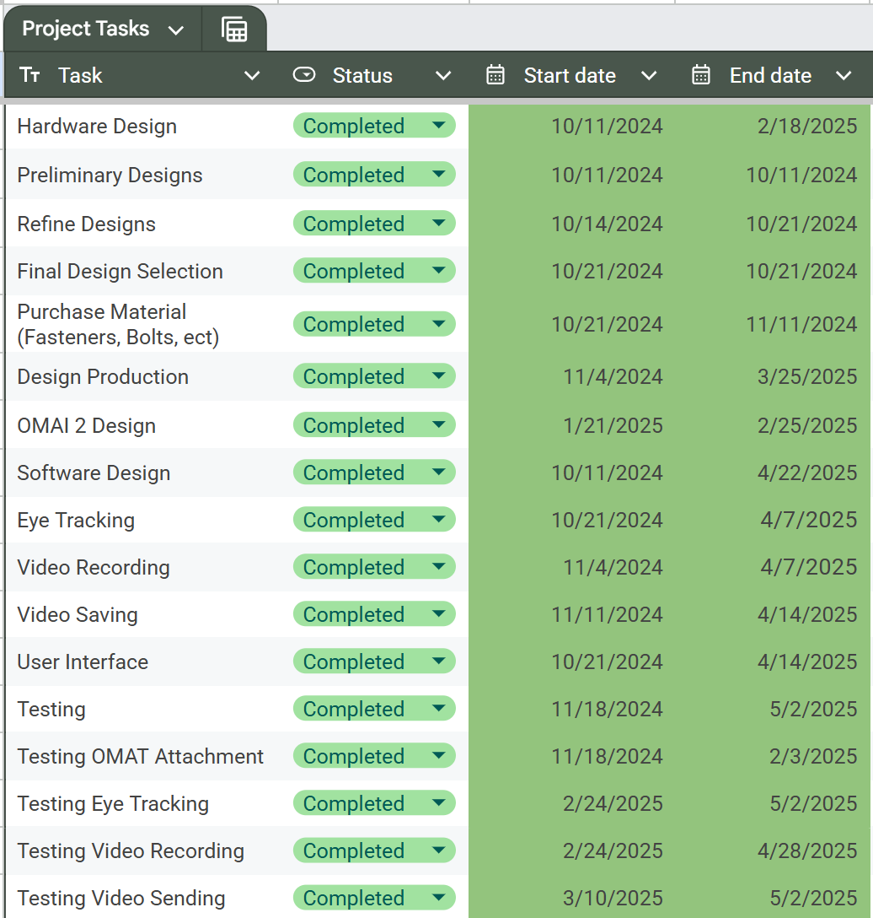
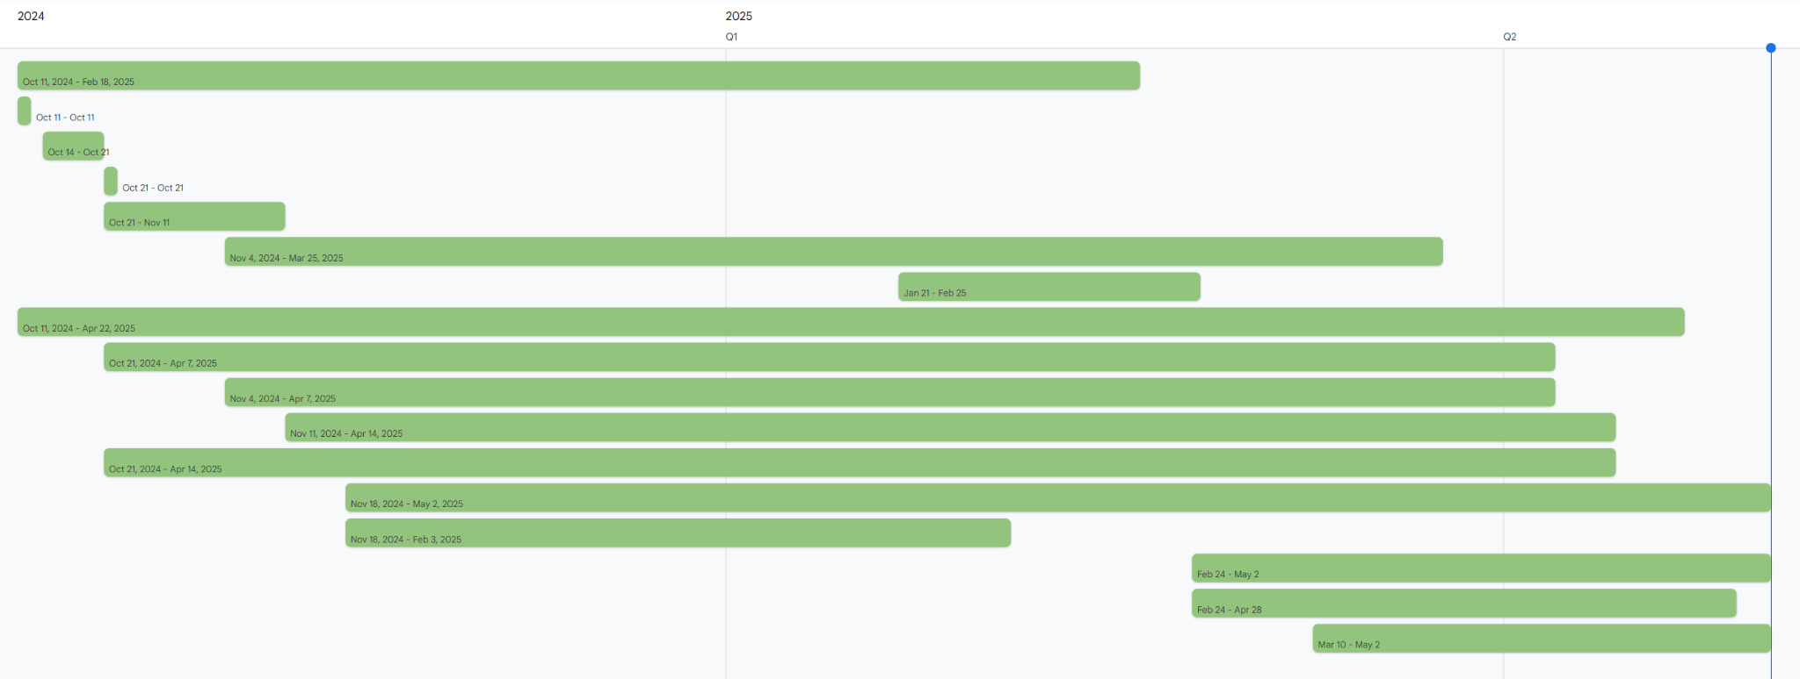
High Level Schedule
Notes:
Ryan(Discussion of how well the schedule was met)
Next Sem Plans:
Physical Design for OMAT 2
More Ansys analysis
Finish app
Most time goals have been met
We needed to rework our design matrix and final design to be in line with our advisor which causes us to miss our predicted deadline for ordering materials
As of now materials have been orders and we are back on schedule

Slide 13
industrial standards
Operational Standards:
IEC 62304 – A system must be set in place to allow for the maintenance of the code. Tests must be performed to ensure code will not harm someone and documentation must be made about the code.
This can be tested with repeated analysis of the Software through in App testing
ISO 20416 – Medical devices Post-market surveillance for manufacturers
This will be tested by assessing all customer feedback alongside viewing all reports of damages or malfunctions
IEC/TR 80001-2-2:2012 – Application of risk management for IT-networks incorporating medical devices-Part 2-2: Guidance for the communication of medical device security needs, risks and controls
This will be assessed by doing software assessments to ensure the security of the system
Safety Standards:
ISO 14971 – Application of risk management to medical devices
This standard will be assessed with a hazard analysis
ISO 10993 – Ensures that materials used in medical devices are biocompatible and safe for human contact
Test will involve a direct contact skin irritation test to determine if prolonged exposure to the OMAI results in any reactions.
ISO 60366-1 – Ensuring the usability of the device, in that it does not pose a safety risk to any users
The usage of the OMAI will be tested in conjunction with the nose piece to ensure that the drive does not easily move from the nose, which may cause eye injury
Notes:
Ryan

Slide 14
Lessons Learned
Besides looking at external solutions, we should also look into existing React Native libraries and plugins for better compatibility and to reduce technical complications.
Using local app storage is easier than saving to a user directory on a device (like the documents folder)
UI scaling throughout multiple devices requires a mix of different methods for it to look satisfactory.
You need a Mac in order to build an iOS app.
It is important to coordinate what changes will be made (software and hardware) to the whole team to avoid duplication/conflict of work.
Notes:
Melvin
Simple/native solutions first
UI scaling needs multiple techniques
If you build an iPhone app, get a mac
Teamwork and communication

Slide 15
Capstone I & II: Final vs. Budgeted Costs
Capstone 1
Production Budget |  | Development Budget
Stainless Steel Spring Kit | $9.89 | FDM 3D Printing at BME Lab Total ~300g | $18
0.5x5x15mm/0.02"x0.2"x0.59" Springs | $10.99
Cyanoacrylate Adhesive (2 oz) | $12.59
Polyurethane Foam Sheet 1/16"x12”x24" | $15.62
Production Total | $49.09 | Development Total | $18
Semester 1 Total |  | $67.09
Capstone 2
Production |  | Development
Stainless Steel Nuts | $9.99 | FDM 3D Printing at BME Lab Total ~500g | $30
Stainless Steel Set Screws | $8.99
Stainless Steel Thumb Set Screws | $8.99
Production Total | $27.97 | Development Total | $30
Semester 2 Total |  | $57.97
Course Total |  | $125.06
Notes:
Ryan

Slide 16
Next Steps
Automated dependency management and builds using GitHub Actions
Migrating cloud from AFS to Amazon Web Services
App Store and Google Play Store approval to publish/distribute the app
Integrate iCloud Drive storage using React Native libraries
Remove clips as consumers will not need to open the top case
Notes:
Melvin

Slide 17
Roles and Responsibilities
Jonathan Scarduffa
Melvin Shajee
Ryan Wilbur
Bryan Xavier
OMAI
Product Design and Design Refinement
OMAPP
Software Design and Eye tracking
OMAI
Product Design and Material Research
OMAPP
Software Design and User Interface
Notes:
Ryan
Melvin - Software Design and Eye tracking
Bryan - Software Design and User Interface
Jon - Product Design and Design Refinement
Ryan - Product Design and Material Research

Slide 18
Thank You For Your Time
Do you have any questions?
Notes:
For the love of god do not forget to remove this

